Slide 1
Docker Introduction
VishwanaTH m s
VISHWACLOUDLAB.com

Slide 2
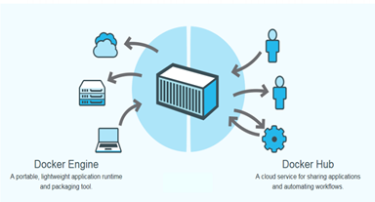
Docker
Open platform for developers and system administrators to build and test cloud applications

Slide 3
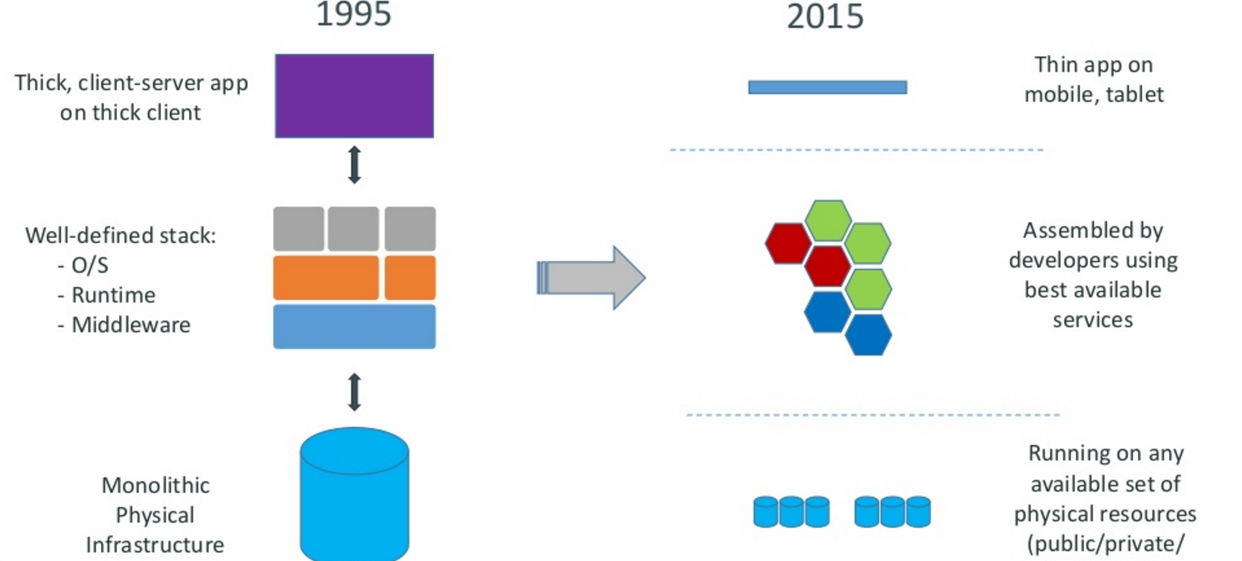
Motivation for the Creation of Containers

Slide 4
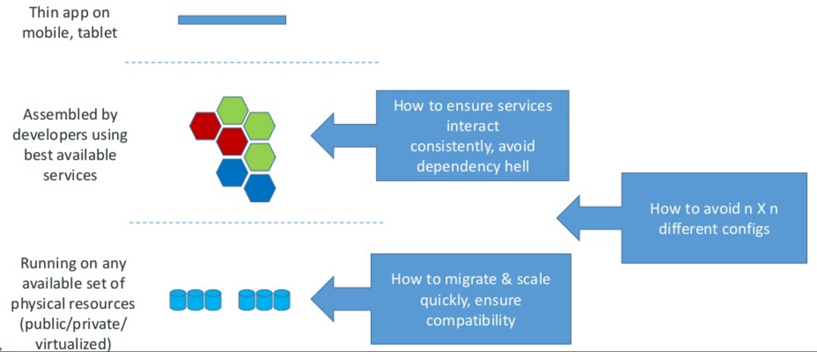
The challenge

Slide 5
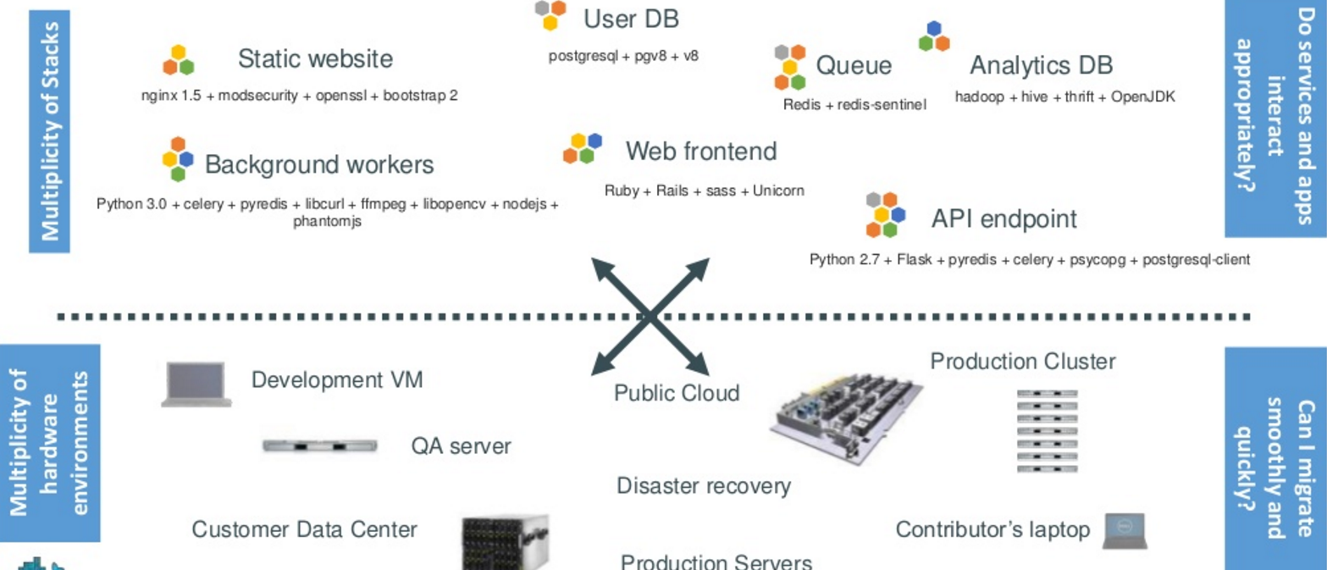
The challenge continued
Notes:
Static web: nginx is a fast webserver, generally faster than Apache
Queue: Redis = in-memory data structure store, used as a database, cache and message broker.
Analytics DB: Hadoop = Hive = Hadoop based Database, Thrift =

Slide 6
What were some of these technologies??
Static web: nginx is a fast webserver, generally faster than Apache
Queue: Redis = in-memory data structure store, used as a database, cache and message broker.

Slide 7
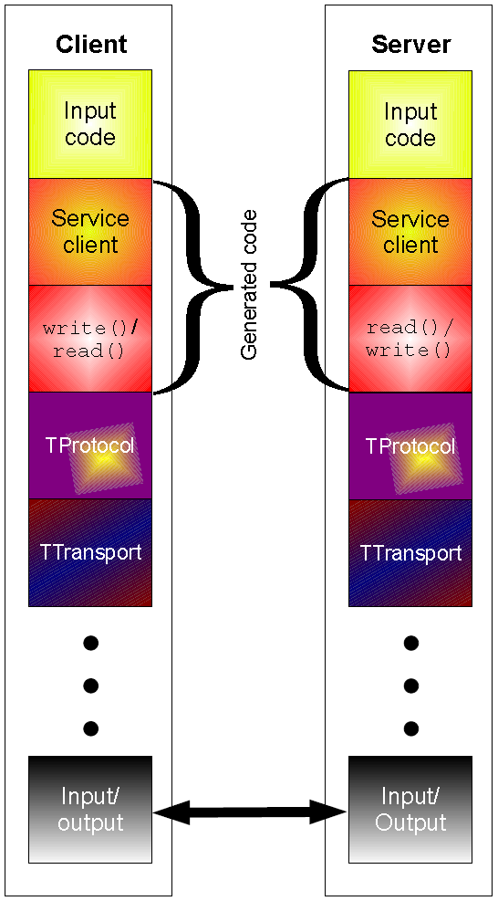
What were some of these technologies??
Analytics DB:
Hadoop = distributed storage and processing of dataset of big data using MapReduce programming model
Hive = Hadoop based Database, offer SQL-like interfaces with HDFS-based data
---allows these database developers or data analysts to use Hadoop without knowing the Java programming language or MapReduce. Now, instead of challenging MapReduce code, you can design a star schema data warehouse or a normalized database.
Thrift = used to define and create services for numerous languages.^{[2]}
It is used as a remote procedure call (RPC) framework and was developed at Facebook for "scalable cross-language services development".

Slide 8
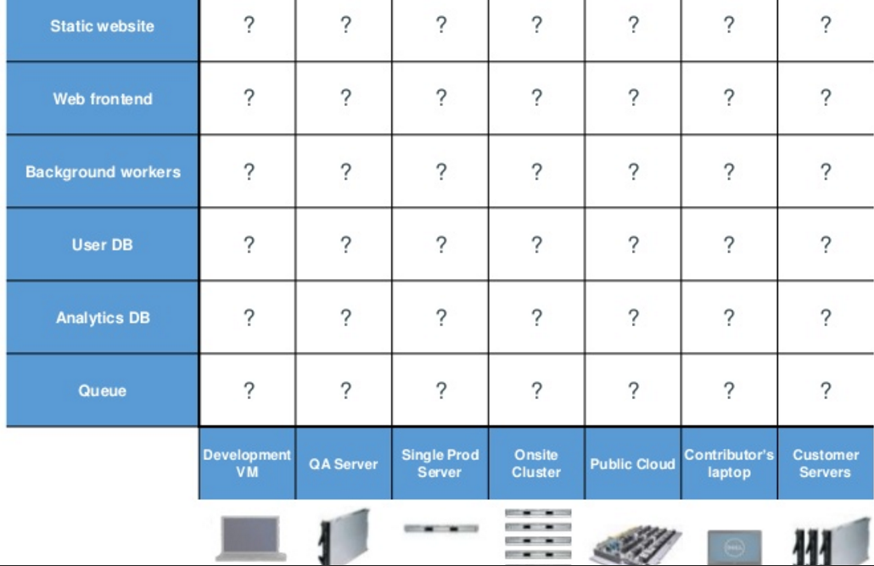
Looking for all kinds of solutions…
Too many to consider

Slide 9
THE ANSWER
Something called a CONTAINER ----which is the business Docker has created.

Slide 10
Huh??? Container
Here is an analogy that Docker use’s to let you understand….

Slide 11
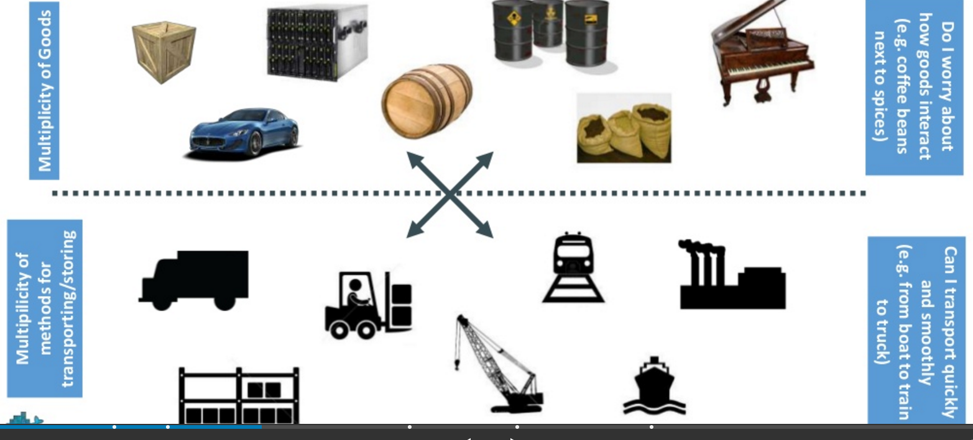
Understanding….an analogy …cargo transport pre-1960

Slide 12
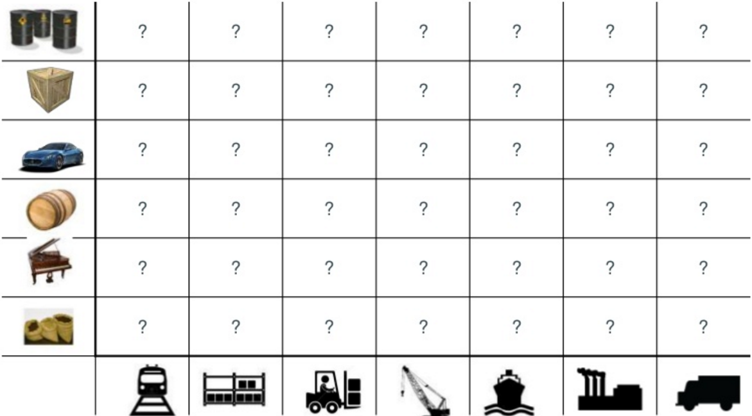
What are the possibilities

Slide 13
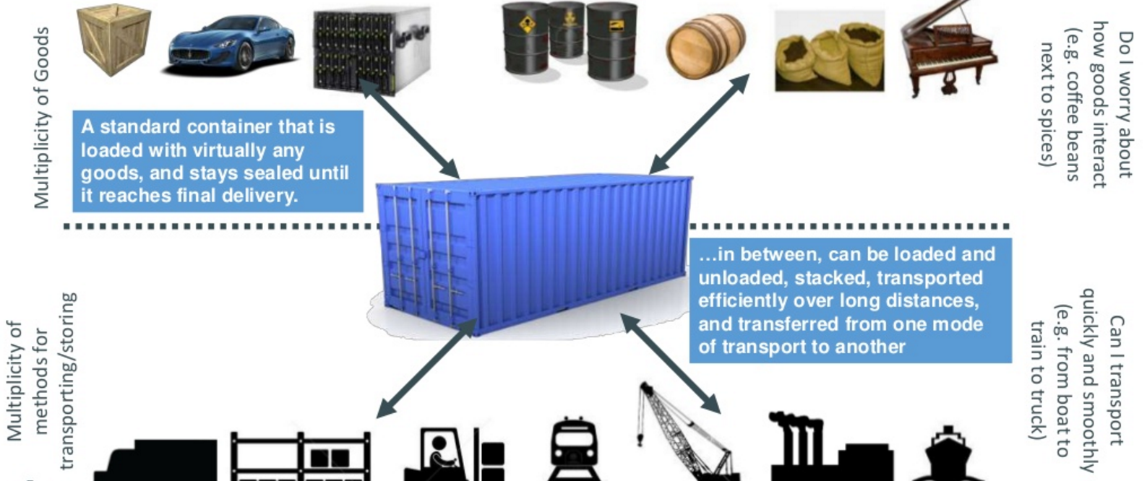
SOLUTION—shipping containers

Slide 14
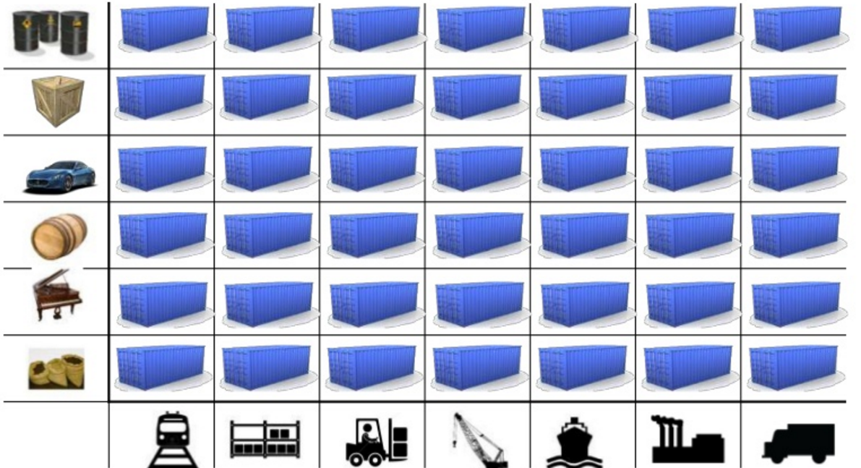
This solved the problem

Slide 15
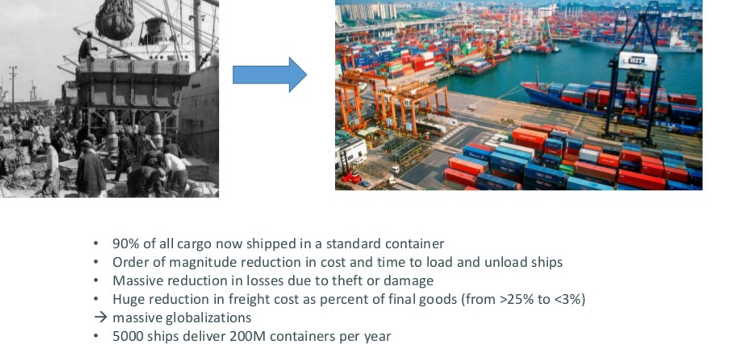
Today shipping is done with containers

Slide 16
How does this container idea translate to our problem

Slide 17
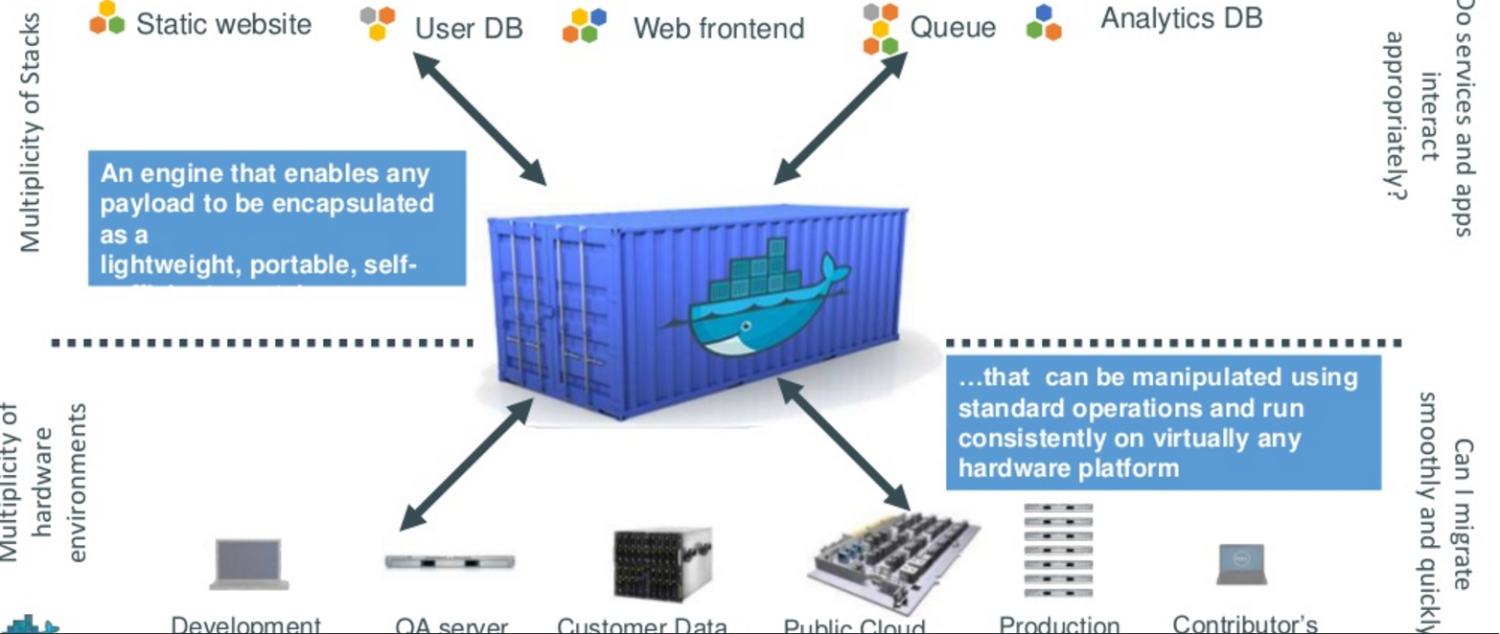
How does this container idea translate to our problem—container for code????

Slide 18
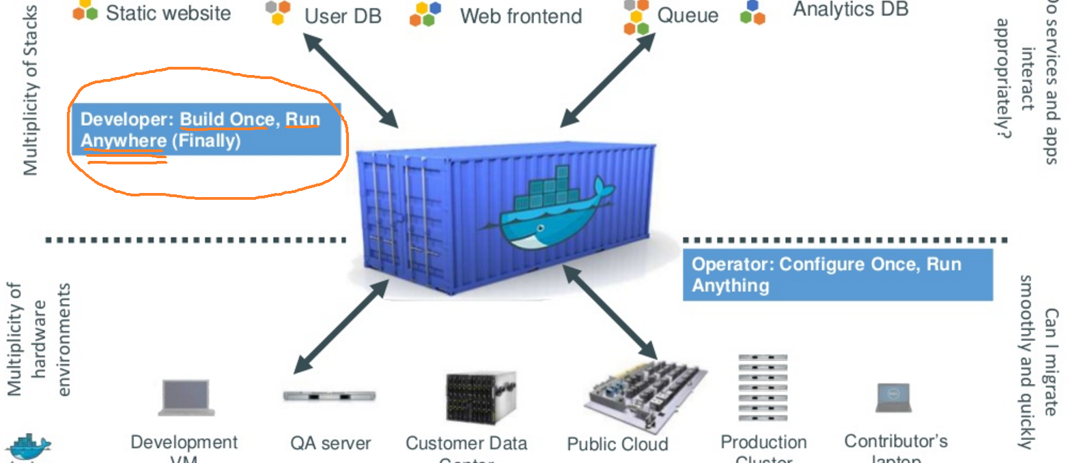
Do once run anywhere

Slide 19
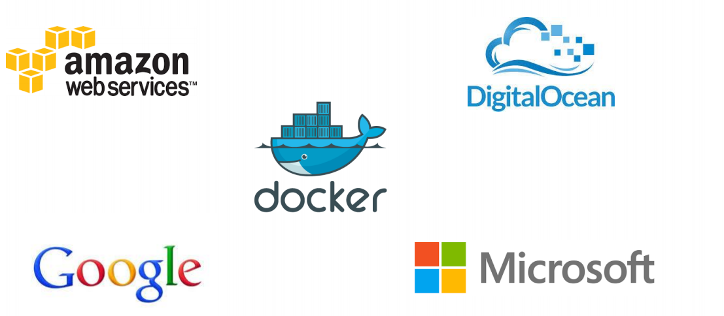
Docker supported in many Cloud platforms

Slide 20
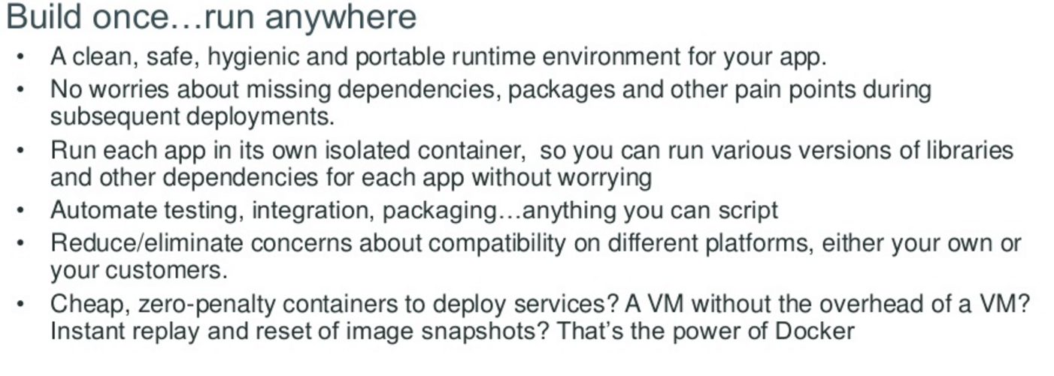
Docker container—developer viewpoint
Build once … run anywhere

Slide 21


Slide 22
SW - Controller Switch
1, 2 ,3
MYSQL – 5.6.4
SW - Relay Switch
4, 5 ,6
MYSQL-5.2.1
Hardware and an OS

